Slide 1
The Budget Hawk
Austin Smith, Jack Hamilton, Kevin Hudson, Kylee Mucher

Slide 2
Overview
The Budget Hawk is designed to help monitor budgetary expenses and ensure no overspending occurs.
Compares Police Department funding vs crime rates
Compares police department funding vs other city services
Easy to read and understand
Empowers users to be informed

Slide 3
Our Target Audience
Policy makers
Concerned citizens

Slide 4
Demo: Karen
Karen is a middle-aged woman that likes to do her own research. She worries about her community with recent calls to defund her local police department, so she wanted to see the facts for herself. She wants to see how police department funding compares to other departments and the crime rates within her city.
Karen lives in Raleigh, North Carolina

Slide 5
Demo: Trayvon
Trayvon is a young man that has recently become engaged in local activism. He wants to track how much his local city budget has been allocated to police departments over the years. He’s specifically seeking to find information that proves police department funding has increased independent of crime rates, so he can sway his fellow community members and elected representatives at local meetings.
Trayvon lives in Charlotte, North Carolina.

Slide 6
Demo: Tobin
Tobin is a local representative that is seeking to quickly inform himself about the history of the allocation of the city’s budget. He is seeking to compare police department funding to crime rates specifically violent crimes within his city. He wants this information to be easily readable and understandable, so his constituents will be able to understand it.
Tobin is a representative in Austin, Texas

Slide 7
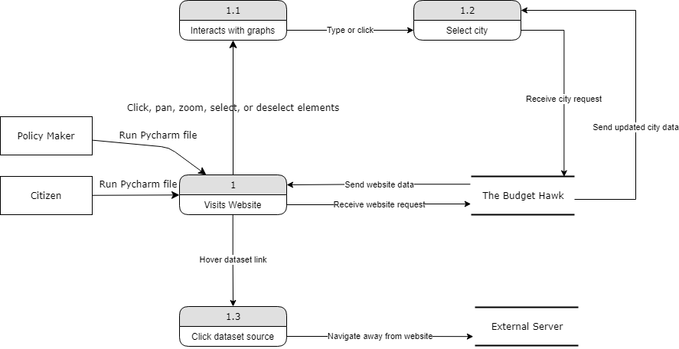
Our System Model

Slide 8
Customer Feedback
Additional explanation of data, as visitors may not understand all the terminology used.
The Budget Hawk is a thorough analysis of crime statistics in America, mostly in reference to the budget of governments and the rates of crime corresponding. The project itself is very streamlined and simplistic, delivering to the user a compact statistical analysis that feels smooth and not too much to take in. The one thing that I can deliver criticism about is that some of the data in the graphs is hard to understand as the titles of some of the data do not make sense and are not explained to the user. Other than that, the project delivers a clean analysis of crime rates vs. police budgeting in the United States.

Slide 9
Future Implementation
Our team would like to have the application automatically collect datasets from their respective sources, allowing for the graphs to always stay updated with the latest information.
Our team would like the datasets to cover all cities within the United States or hopefully the entire world. As of right now, our datasets only cover 56 US cities and includes national data for the US. Thus, if we increase the scope of our datasets our application will have increased reach and relevance.

Slide 10
Major Obstacles and Lessons Learned
Obstacles:
Understanding our data and determining how our team should utilize and organize it.
How are graphs generated.
Lessons learn:
There is a need for more descriptions and information, so users are able to understand what they are looking at and how to read/use the data.
Learned how to code using Dash Plotly and improved our coding skills overall.
Learned how to obtain data using .csv files and learned how to utilize that data to generate graphs.

Slide 11
Thank you for listening

